Slide 1




Traffic Portal
User Interaction
https://video.demo1.mycdn.ciab.test/foo.png
Postgres
Admins
And Users
Traffic Ops API
Traffic Portal

Slide 2
Traffic Router Interaction
(HTTP)
https://video.demo1.mycdn.ciab.test/foo.png
.ciab.test
Client(s)
DNS Server

Slide 3
Traffic Router Interaction
(HTTP)
https://video.demo1.mycdn.ciab.test/foo.png
1
.ciab.test
Client(s)
4
DNS Server
2
3
*.mycdn.ciab.test
Traffic Router

Slide 4
Traffic Router Interaction
(HTTP)
https://video.demo1.mycdn.ciab.test/foo.png
1
.ciab.test
Client(s)
4
5
DNS Server
2
3
302 Redirect
6
*.mycdn.ciab.test
Traffic Router

Slide 5


Traffic Router Interaction
(HTTP)
https://video.demo1.mycdn.ciab.test/foo.png
1
.ciab.test
Client(s)
4
5
7
DNS Server
2
3
302 Redirect
6
*.mycdn.ciab.test
foo.png
Traffic Router
8
Traffic Server
EDGE-TIER
Traffic Server
MID-TIER
CDN Tenant
Origin

Slide 6
Traffic Router Interaction
(DNS)
https://video.demo1.mycdn.ciab.test/foo.png
1
.ciab.test
Client(s)
4
5
DNS Server
3
2
*.mycdn.ciab.test
foo.png
Traffic Router
6
Traffic Server
EDGE-TIER
Traffic Server
MID-TIER
CDN Tenant
Origin

Slide 7
Traffic Router
and
Traffic Monitor
Polling
Postgres
Traffic Ops API
/api/federations
/api/steering
/api/sslkeys
/api/crconfig
/api/deliveryservices
/api/cachegroups
/api/servers
/czmap.json
/GeoIP2-city.mmdb
/api/crconfig
GeoIP server
Traffic Router
Traffic Monitor

Slide 8
ORT Config Polling
Postgres
Traffic Ops API
ORT config
downloads
ORT config
downloads
Traffic Server
EDGE-TIER
Traffic Server
MID-TIER

Slide 9

Traffic Control in Docker
Host
Docker Network
Traffic Control
Traffic Control in Docker
TRAFFIC
OPS
ENROLLER
Upstream
DNS Server
BIND DNS
DNS Routing
TRAFFIC VAULT
TRAFFIC SERVER
MID-TIER
TRAFFIC SERVER
EDGE-TIER

Slide 10
Traffic Control in Docker
Host
Docker Network
Traffic Control
Traffic Control in Docker
TRAFFIC
OPS
Enrolls with
Traffic Ops
ENROLLER
Upstream
DNS Server
TRAFFIC
PORTAL
TRAFFIC
MONITOR
BIND DNS
DNS Routing
TRAFFIC VAULT
TRAFFIC SERVER
MID-TIER
TRAFFIC SERVER
EDGE-TIER

Slide 11
Traffic Control in Docker
Host
Docker Network
Traffic Control
Traffic Control in Docker
TRAFFIC
OPS
Enrolls with
Traffic Ops
ENROLLER
Upstream
DNS Server
TRAFFIC
PORTAL
TRAFFIC
MONITOR
BIND DNS
DNS Routing
TRAFFIC
VAULT
TRAFFIC
ROUTER
TRAFFIC VAULT
TRAFFIC SERVER
MID-TIER
TRAFFIC SERVER
EDGE-TIER

Slide 12
Traffic Control in Docker
Host
Docker Network
Traffic Control
Traffic Control in Docker
TRAFFIC
OPS
Enrolls with
Traffic Ops
ENROLLER
Upstream
DNS Server
TRAFFIC
PORTAL
TRAFFIC
MONITOR
BIND DNS
DNS Routing
TRAFFIC
VAULT
TRAFFIC
ROUTER
TRAFFIC VAULT
TRAFFIC SERVER
MID-TIER
TRAFFIC
SERVER
MID
ORIGIN
TRAFFIC
SERVER
EDGE
TRAFFIC SERVER
EDGE-TIER

Slide 14
Traffic Control Communication
https://routing-name.ds-name.cdn.apache.org/foo.png
Postgres
Client(s)
Traffic Monitor
Traffic Ops API
Traffic Router
ORT config download
ORT config download
foo.png
Traffic Server
EDGE-TIER
Traffic Server
MID-TIER
CDN Tenant
Origin

Slide 15
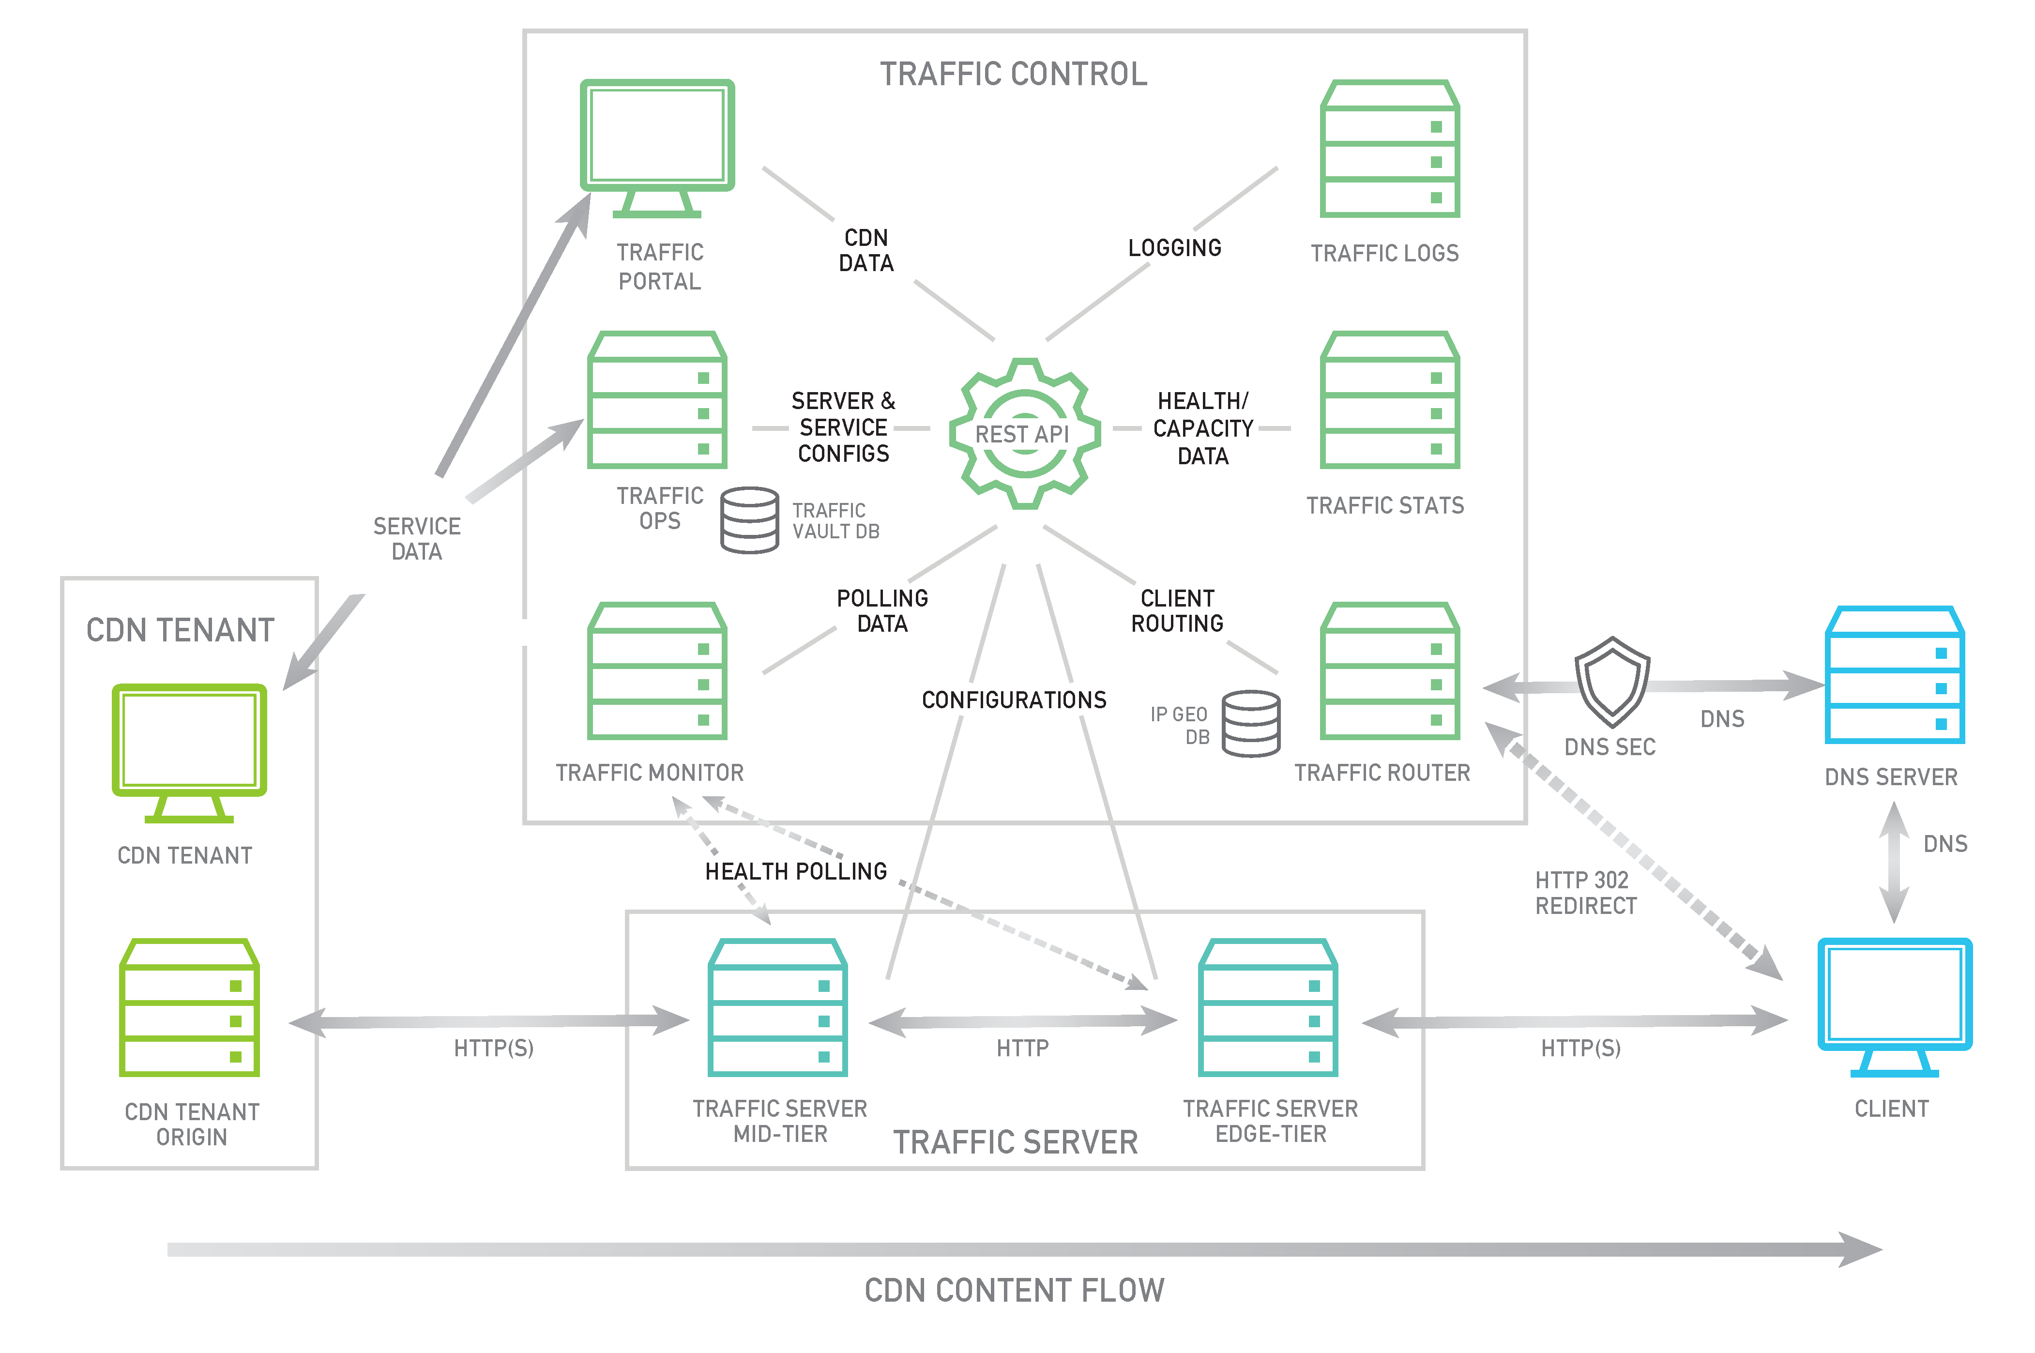
Traffic Control Overview

Slide 16
Traffic Router Interaction
(DNS)
https://video.ciab.cdn.local/foo.png
1
2
4
Client(s)
DNS Server
3
5
Traffic Router
foo.png
6
Traffic Server
EDGE-TIER
Traffic Server
MID-TIER
CDN Tenant
Origin

Slide 17
Traffic Router and Monitor Polling
Traffic Router
Traffic Monitor
ORT config download
Postgres
ORT config download
Traffic Ops API
Traffic Server
EDGE-TIER
Traffic Server
MID-TIER

Slide 18
Traffic Router Interaction
(HTTP)
https://video.ciab.cdn.local/foo.png
302
redirect
Client(s)
Traffic Router
foo.png
Traffic Server
EDGE-TIER
Traffic Server
MID-TIER
CDN Tenant
Origin

